Slide 1

Department of BES-II
BASIC ELECTRICAL & ELCTRONIC CIRCUITS (BEC)
COURSE CODE : 23EC1203
Topic:
Circuit fundamentals
Session – No.1

Slide 2



AIM OF THE SESSION
To familiarize students with the basic concept of basic electrical and electronic circuits
INSTRUCTIONAL OBJECTIVES
This Session is designed to:
Demonstrate recognition of independent and dependent sources.
Describe the purpose of independent sources in circuits.
List out the different types of dependent sources.
Describe the behaviour of RLC circuits.
Describe the Ohm’s Law, KVL and KCL
LEARNING OUTCOMES
At the end of this session, you should be able to:
Define the characteristics of RLC elements.
Describe how resistors, capacitors, and inductors interact within RLC circuits.
Summarize the role of circuit elements in electrical systems
Use of Ohm’s Law, KVL and KCL for solving different electrical circuits.

Slide 3
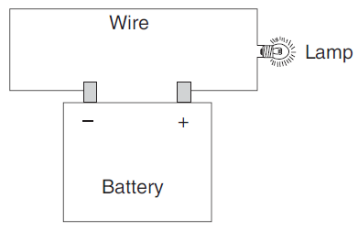
Electrical Circuit
An Electric circuit is an interconnection of various elements in which there is at least one closed path in which current can flow. An Electric circuit is used as a component for any engineering system.

Slide 4
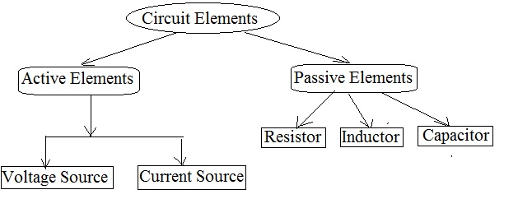
ELEMENTS OF AN ELECTRICAL CIRCUIT

Slide 5



Basic Electrical Quantities
Voltage: Voltage, also known as electric potential difference, is the measure of electric potential energy per unit charge in an electrical circuit. Voltage is measured in volts (V).
Current: Electric current is the flow of electric charge in a conductor, such as a wire. It is the rate of flow of electric charge through a circuit. The unit of measurement for electric current is the ampere (A).
Power : Power in an electrical context is the rate at which work is done or the rate at which energy is transferred or converted. It is the product of voltage and current and is measured in watts (W)
$v= \frac{dw }{dq} \frac{Joules}{Coulomb}$ V
$i= \frac{dq }{dt} \frac{Coulomb}{second}$A
$P= \frac{dw }{dt} \frac{Joule}{second}$ watt

Slide 6
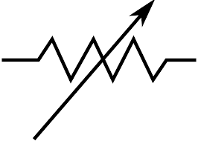

Resistor
Definition: Resistor is an electronics component which provides the specifies amount of opposition (resistance) to the flow of current.
It can be a fixed value or a variable resistor.
Unit: The value of resistor is called resistance. It is denoted by R and the unit of resistance is Ohms (Ω).
Symbol:
𝑉=𝐼 𝑅
𝐼= 𝑉/𝑅
𝑅= 𝑉/𝐼
Conductance 𝐺=1/𝑅
Units of Conductance is mho or Siemens
Fixed Resistor
Variable Resistor
V-I Characteristics of R

Slide 7
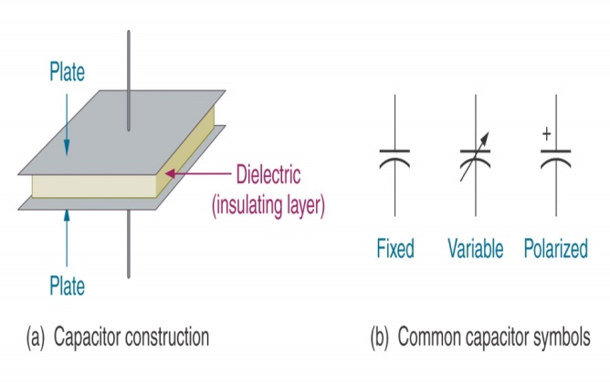
Capacitor
Definition: A capacitor is an electronic component that stores electrical energy in an electric field.
Unit: The value of capacitor is called capacitance. It is denoted by C and the unit of capacitance is farads.
Symbol:
Capacity is directly proportional to charge and inversely proportional to voltage
E_{stored} = ½CV²
where
C = the capacity (or capacitance) of the component, in coulombs per volt, or Farads
Q = the total charge stored by the component
V= the voltage across the capacitor
V-I Characteristics of C

Slide 8
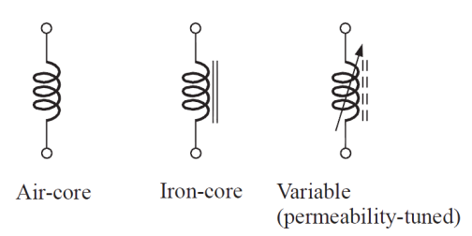

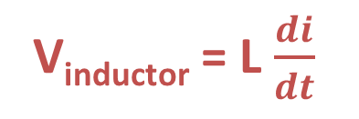
Inductor
Definition: An inductor is essentially a coil of wire with an iron core. They store energy in magnetic field. An inductor is an electromagnet.
Unit: The value of inductor is called inductance. It is denoted by L and the unit of resistance is henry (H).
Symbol:
Energy Stored in an Inductor
E_{stored} = ½LI²
Inductor
V & I relationship of a Inductor
L-Inductance-Henry
V-I Characteristics of L

Slide 9
Resistors in Series
Resistors in Parallel
Inductors in Series
Inductors in Parallel
Capacitors in Series
Capacitors in Parallel
Voltage Division Rule
Current Division Rule

Slide 10
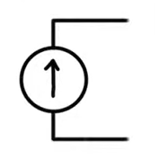
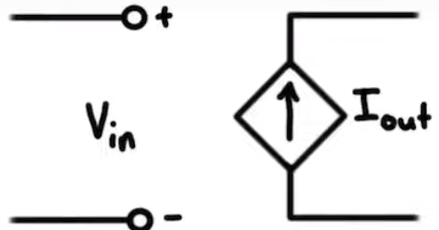
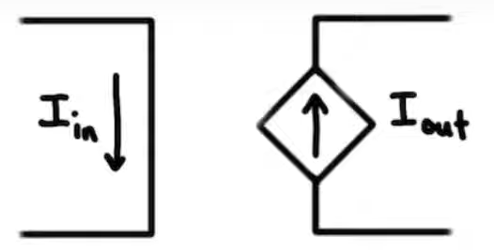
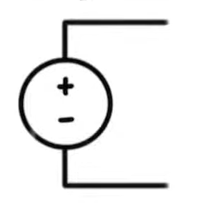
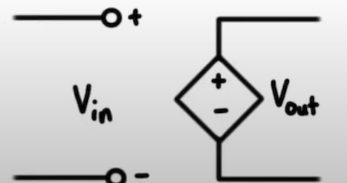
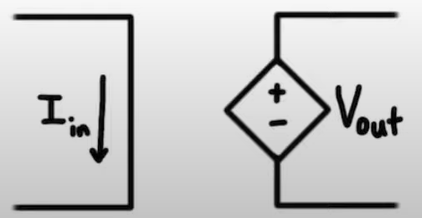
Energy Sources
Independent Source
Dependent Source
The source which does not depend on any other quantity like voltage and current) in the circuit.
The source whose output value depends upon the voltage or current at some other part of the circuit..
Voltage Controlled Current Source
Current Controlled Current
Voltage Controlled Voltage Source
Current Controlled Voltage
Voltage Source
current Source

Slide 11
Ideal Voltage Source
Ideal Current Source
Real (Practical) Voltage Source
Real (Practical) Current Source
OC
SC

Slide 12
node, branch , loop, MESH
Node – any point where 2 or more circuit elements are connected together.
Each node has one voltage (w.r.t. ground)
Branch – a circuit element between two nodes.
Loop – a collection of branches that form a closed path returning to the same node without going through any other nodes or branches twice.
Mesh – a mesh a Loop in which there are no inner loops.

Slide 13
Kirchoff’s Laws
Kirchhoff's Voltage Law (KVL) states that the total voltage around any closed loop in a circuit is zero.
The algebraic sum of voltages around each loop is zero.
Σ Voltage Drops - Σ Voltage Rises = 0
Kirchhoff's Current Law (KCL) states that the total current entering a node in an electrical circuit is equal to the total current leaving the node.
The algebraic sum of currents entering a node is zero
Σ Currents In - Σ Currents Out = 0
Sign Convention

Slide 14
Numerical Problems
Problem 01
Problem 02
Problem 03
Problem 04
Problem 05
Problem 06

Slide 15

TERMINAL QUESTIONS
1. Describe Explain the fundamental difference between independent and dependent sources in an electrical circuit.
2. Summarize the importance of resistor, capacitor, inductor in an electronic circuit.
3.Explain how Kirchhoff's Voltage Law and Kirchhoff's Current Law can be applied together to analyze the circuit's behavior.
4.List out the classification of active and passive elements.

Slide 16
SELF-ASSESSMENT QUESTIONS
Which law states that the total current entering a junction is equal to the total current leaving the junction in a circuit?
Ohm's Law
Kirchoff’s Voltage Law
Kirchoff’s Current Law
Faradays Law
Which component stores electrical energy in a magnetic field?
Capacitor
Resistor
Inductor
Diode

Slide 17
REFERENCES & LEARNING SESSION
Reference Books :
1. John bird electrical circuit theory and technology, Routledge publishers, 6th edition
2. “Electric Circuits” by James W. Nilsson and Susan A. Riedel
Sites and Web links:
1. https://archive.nptel.ac.in/courses/108/102/108102097/
2. https://archive.nptel.ac.in/courses/117/106/117106108/

Slide 18
THANK YOU
Team – BEC

